Slide 1


Fundamentals of Risk Management
RM System, Process, & Program
Incident Investigation & Analysis
RM Tools & Challenges
People & Organizations
RM as Applied in Industry
Leadership in RM
Applications & Perspectives
On Becoming a
Leader in Risk Management
ENGG404 - Lecture
Case Study 13:
Mount Polley Tailings Storage Facility Failure, Imperial Metals, near Likely, British Columbia, (August 4, 2014)

Slide 2
Learning Outcomes:
Explore the basis for complacency in the following risk management system elements, and explain:
Management Leadership, Commitment and Accountability
Risk Assessment and Management of Risks
Design, Construction and Start-up
Employee Competency and Training
Recognize a situation where the degradation of management leadership and risk assessment applies to a loss incident, and apply the principles of risk management in a case study analysis.
Update: https://www.cbc.ca/news/canada/british-columbia/discipline-engineers-mount-polley-mine-waste-quesnel-lake-1.6137265
Case 13 Mount Polley LI
2
Notes:
2

Slide 3
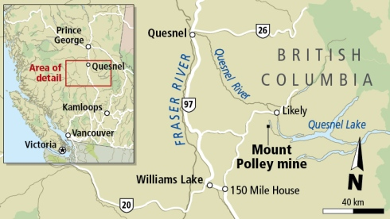
Background:
Mount Polley Mine:
Open pit copper and gold mine
Began operations in 1997
Owned and operated by Mount Polley Mining Corporation (MPMC), a subsidiary of Imperial Metals Corporation
Processes ~21,000 tonnes of ore per day
Case 13 Mount Polley LI
3
Notes:
3

Slide 4
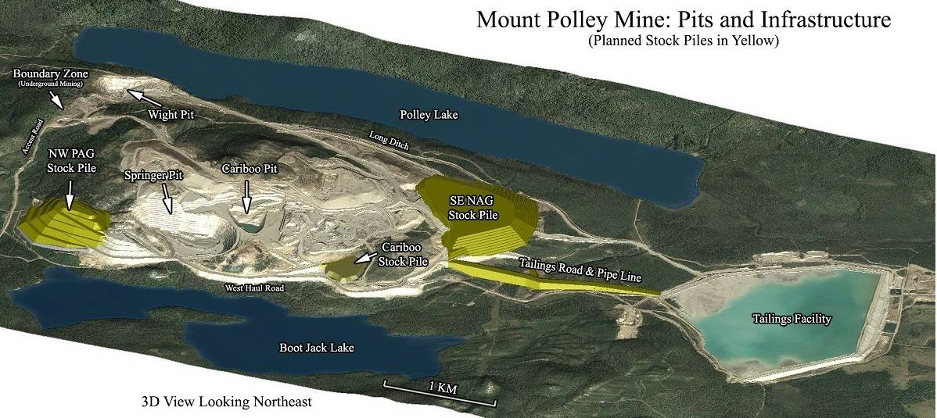
Mount Polley Mine Layout:
Case 13 Mount Polley LI
4
Notes:
4

Slide 5
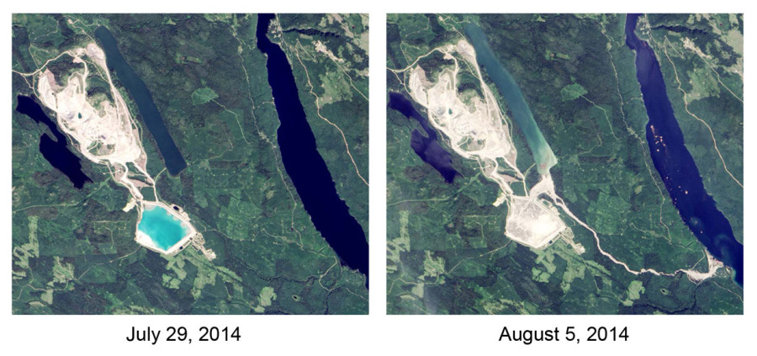
Mount Polley – Before and After the Technical Loss Incident:
BEFORE
The Tailings Storage Facility (TSF) is intact – the blue pond.
AFTER
The TSF has failed.
Case 13 Mount Polley LI
5
Notes:
5

Slide 6
Impacts on PEAP:
People: | Drinking-water ban for about 300 local residents for over 1 week Livelihoods impacted (tourism, fishing)
Environment: | 25M m³ of mining waste and contaminated water released into Lake Polley, Hazeltine Creek and Quesnel Lake. $70M spent on remediation efforts for environmental cleanup.
Assets: | Damaged/failed Tailings Storage Facility (TSF) Stock price drop of ~41% Disciplinary hearings for 3 engineers of record (EoRs) for alleged negligence and unprofessional conduct.
Production: | Facility shutdown for 1 year Full operations resumed in July 2017
Case 13 Mount Polley LI
6
Notes:
6

Slide 7
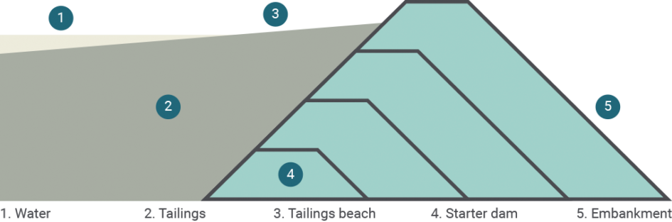
Immediate (and Intermediate) Causes:
The weak clay layer below embankment failed from excessive stress due to:
  Overly steep slope downstream of the embankment
  Embankment height higher than design standards (~40m)
  Open sub-excavation at the toe of the embankment
  Surplus of water in TSF (Tailings Storage Facility)
  Insufficient tailings beaches to protect embankment structure
Case 13 Mount Polley LI
7
Notes:
7

Slide 8
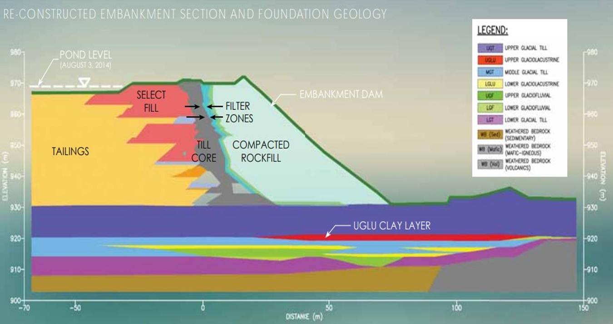
Technical Causes of the Incident:
The embankment dam structure failed.
Case 13 Mount Polley LI
8
Notes:
8

Slide 9
Basic Causes:
Engineering and Design Factors:
Inadequate evaluation of change: Risks introduced by the sub excavation activity at the toe of the embankment were not identified nor assessed.
Inadequate monitoring of construction: Subexcavation remained open for 8 months without any concern from engineers or management.
Job Factors:
Inadequate guidance manuals: The construction manual for buttress excavation did not include any construction procedures.
Inadequate inspection/monitoring: Inadequate supervision during TSF operations
Inadequate work planning: Inadequate water management plan
Personal Factors:
Improper risk taking: Design engineers were overconfident in their professional judgement
Case 13 Mount Polley LI
9
Notes:
9

Slide 10
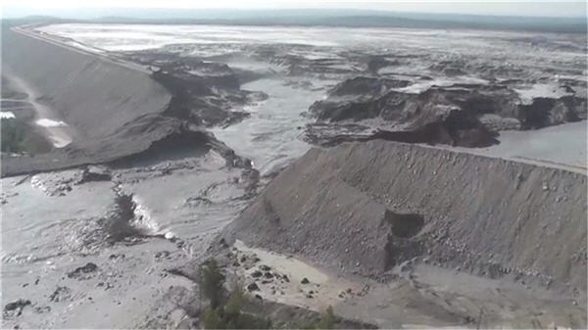
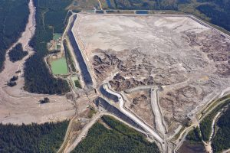
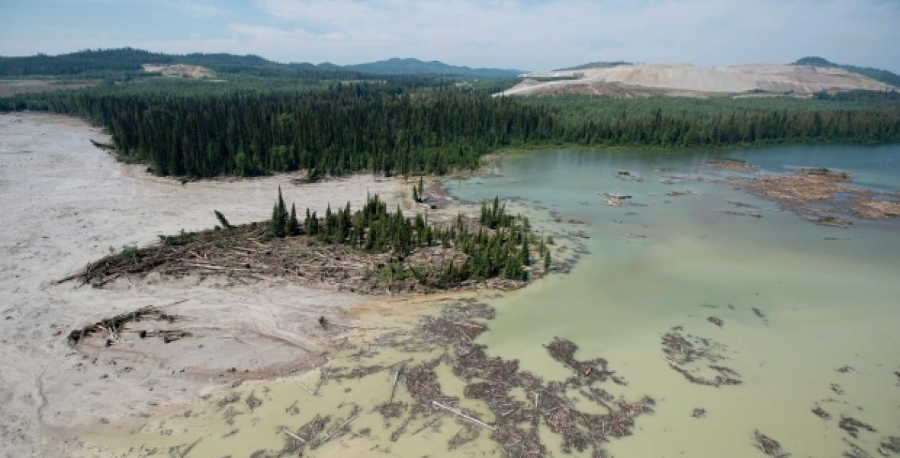
Mount Polley – Latent Causes and Lessons in Leadership:
It is vital to combat complacency in all aspects
of risk management.
Using this list, select one and think about possible
causes of failure in organizational leadership:
Management Leadership, Commitment and Accountability
Risk Assessment and Management of Risks
Community Awareness and Emergency Preparedness
Management of Change.
Incident Reporting, Investigation, Analysis and Actions
Program Evaluation and Continuous Improvement.
Design, Construction and Start-up
Operations and Maintenance.
Employee Competency and Training.
Contractor Competency and Integration.
Operations and Facilities Information and Documentation.
Case 13 Mount Polley LI
10

Slide 11
An Examination of the Weaknesses in RM Elements (LC’s):
#1 MLCA:
Lack of management commitment, leadership, and accountability
Management ignored previous warnings and concerns from Regulator and employees
#2 RA&MR:
Inadequate risk assessment and management of risk
Insufficient hazard identification during operations in TSF
Management provided inadequate supervision and inspections during operations
#7 DC&SU:
Inadequate design and assessment
Design team had a poor understanding of underlying terrain during the design phase of TSF
Design team heavily relied on Factor of Safety calculations prone to error
#9 EC&T:
Inadequate employee competency
Unqualified personnel overseeing water management program
Case 13 Mount Polley LI
11
Notes:
11

Slide 12
Mount Polley LI: Latent Cause Relating to RME#2
RME #2: Risk Assessment and Management of Risks:
  Initial and on-going, continuing need to assess and manage risks.
    Substandard hazard identification program resulted in unaddressed risks during the operations phase of the TSF:
    TSF Inspections were not adequately performed nor adequately supervised
    Latent Cause:
    LC-S: The risk assessment program did not include a standard to identify and assess hazards of the TSF foundation and hydraulic conditions while the TSF was in operation. #2 RAMR
Case 13 Mount Polley LI
12
Notes:
12

Slide 13
Mount Polley LI: Latent Cause Relating to RME#7
RME #7: Design, Construction and Start-up:
  Risk assessment during design is vital to assess and control the risks.
  Design team heavily relied on Factor of Safety (FoS) calculations, but they were not reliable.
    Used unsuitable calculation guidelines from the Canadian Dam Association
    Calculations used data from an inadequate assessment, leading to incorrect calculations
  The Mining Association of Canada’s guidelines were not followed.
    Design team relied more on their professional judgement
    Guidelines would have likely identified most of the key technical causes.
    Latent Cause:
    LC-S: The design program standard for applying the factors of safety during the design phase of the TSF project did not reference the necessary calculation guidelines from the Mining Association of Canada. #7 DCSU
Case 13 Mount Polley LI
13
Notes:
13

Slide 14
Mount Polley LI: Latent Cause Relating to RME#9
RME #9: Employee Competency and Training:
  Must ensure that employees are fully competent.
    The individual who was hired to lead the water management plan was not qualified. Through the actions of this individual, this resulted in excess water levels in the TSF.
    Latent Cause:
    LC-S: The employee competency program standard for recruiting, selecting, and hiring new employees was inadequate. #9 ECT
Case 13 Mount Polley LI
14
Notes:
14

Slide 15
Mount Polley LI: Latent Cause Relating to RME#1
RME #1: Management Leadership, Commitment, and Accountability
  Corporate Safety Culture: Leadership influences and drives culture; values and actions define the culture. Both a good culture and sound risk management program are necessary for sustainable performance.
  The concerns of employees and regulators about the TSF were ignored by Imperial Metals management.
  Latent Cause:
  LC-S: The leadership program did not include a management standard to assign responsibility and drive accountability for oversight of the safe TSF operation in addressing safety concerns. #1 MLCA
Case 13 Mount Polley LI
15
Notes:
15

Slide 16
Mount Polley LI: Recommendations Based on Latent Causes?
What recommendations could you make for each latent cause?
  LC-S: The leadership program did not include a management plan (standard) to assign responsibility and drive accountability for oversight of the safe TSF operation in addressing safety concerns. #1 MLCA
  LC-S: The risk assessment program did not include a standard to identify and assess hazards of the TSF foundation and hydraulic conditions while the TSF was in operation. #2 RAMR
  LC-S: The design program standard for applying the factors of safety during the design phase of the TSF project did not reference the necessary calculation guidelines from the Mining Association of Canada. #7 DCSU
  LC-S: The employee competency program standard for recruiting, selecting, and hiring new employees was inadequate. #9 ECT
  We will come back to this – how to make recommendations – later in the term.
Case 13 Mount Polley LI
16
Notes:
16

Slide 17
Mount Polley LI: Impact on the Mining Industry
Incident investigations can result in changes beyond the organization involved in the loss incident!
As a result of the Mount Polley incident, several changes were made to guidelines and practices for tailings facilities.
Changes to the Mining Association of Canada’s “A Guide to the Management of Tailings Facilities” (2019) and the B.C. Government’s “Health, Safety and Reclamation Code for Mines in British Columbia” (2017) include:
  Requiring an independent review of site selection, design, construction, operation, investigation, and closure for tailings facilities.
  Improved risk assessment methodology, including a risk-based ranking system for non-conformances.
  Additional regulations for managing the change of Engineers of Record and ownership
  More technical guidance for site selection and design
  But for the purposes of your Team project, limit latent causes (and recommendations to what is within the scope of The ABC Conglomerate).
Case 13 Mount Polley LI
17
Notes:
17

Slide 18
Mount Polley LI: Impact on the Mining Industry
Incident investigations can result in changes beyond the organization involved in the loss incident!
As a result of the Mount Polley incident, several changes were made to guidelines and practices for tailings facilities.
Changes to the Mining Association of Canada’s “A Guide to the Management of Tailings Facilities” (2019) and the B.C. Government’s “Health, Safety and Reclamation Code for Mines in British Columbia” (2017) include:
  Requiring an independent review of site selection, design, construction, operation, investigation, and closure for tailings facilities.
  Improved risk assessment methodology, including a risk-based ranking system for non-conformances.
  Additional regulations for managing the change of Engineers of Record and ownership
  More technical guidance for site selection and design
  But for the purposes of your Team project, limit latent causes (and recommendations to what is within the scope of The ABC Conglomerate).
Case 13 Mount Polley LI
18
Notes:
18

Slide 19

Look into the future about your career …
Q: Will you ever be in this situation?
“Seven years after Canada's largest tailings spill, the two engineers who
were involved have been found in breach of their professional codes
of conduct, Engineers and Geoscientists of British Columbia (EGBC)
The panel found that both Rice and Fidel demonstrated unprofessional conduct in the course of their work at the mine. …
EGBC reported that a discipline hearing panel had imposed a maximum fine of $25,000 against Rice, who resigned in 2018. Rice also agreed to pay $107,500 dollars in legal costs to the association and is no longer permitted to practice as a professional engineer in the province.
A separate discipline hearing panel found that Fidel also committed several acts of unprofessional conduct.”
https://www.cbc.ca/news/canada/british-columbia/discipline-engineers-mount-polley-mine-waste-quesnel-lake-1.6137265
A: Not when practicing the principles and practices of “Leadership in Risk Management”, a key competency!
We will revisit ethics and professional conduct later in the term.
Case 13 Mount Polley LI
19
Notes:
19

Slide 20
Summary and Key Lessons:
It is vital to combat complacency in all aspects of risk management.
How quickly does management address identified deficiencies? Are responsibilities embraced or deflected to others?
#1 MLCA Management Leadership, Commitment, and Accountability
How are hazards identified and assessed throughout the facility lifecycle? Is this system embedded throughout the organization?
#2 RAMR Risk Assessment and Management of Risks
Are accepted standards of practice used for risk assessment during design and other stages? Can the certainty and confidence in obtained results be reasonably justified?
#7 DCSU Design, Construction and Start-up
Are employees fully trained and qualified for their roles? Does management have an effective training program in place?
#9 ECT Employee Competency and Training
Lastly, the key lesson is applying the RM principles, practices, and concepts to analyse a case study / loss incident!
Case 13 Mount Polley LI
20
Notes:
20

Slide 21
Complete Slide Deck follows with details.
21
Notes:
21

Slide 22
Learning Outcomes:
Explore the basis for complacency in the following risk management system elements, and explain:
Management Leadership, Commitment and Accountability
Risk Assessment and Management of Risks
Design, Construction and Start-up
Employee Competency and Training
Recognize a situation where the degradation of management leadership and risk assessment applies to a loss incident, and apply the principles of risk management in a case study analysis.
Case 13 Mount Polley LI
22
Notes:
22

Slide 23
Background:
Mount Polley Mine:
Open pit copper and gold mine
Began operations in 1997
Owned and operated by Mount Polley Mining Corporation (MPMC), a subsidiary of Imperial Metals Corporation
Processes ~21,000 tonnes of ore per day
Case 13 Mount Polley LI
23
Notes:
23

Slide 24
Mount Polley Mine Layout:
Case 13 Mount Polley LI
24
Notes:
24

Slide 25
Mount Polley – Before and After the Technical Loss Incident:
BEFORE
The Tailings Storage Facility (TSF) is intact – the blue pond.
AFTER
The TSF has failed.
Case 13 Mount Polley LI
25
Notes:
25

Slide 26
Impacts on PEAP:
People: | Drinking-water ban for about 300 local residents for over 1 week Livelihoods impacted (tourism, fishing)
Environment: | 25M m³ of mining waste and contaminated water released into Lake Polley, Hazeltine Creek and Quesnel Lake. $70M spent on remediation efforts for environmental cleanup.
Assets: | Damaged/failed Tailings Storage Facility (TSF) Stock price drop of ~41% Disciplinary hearings for 3 engineers of record (EoRs) for alleged negligence and unprofessional conduct.
Production: | Facility shutdown for 1 year Full operations resumed in July 2017
Case 13 Mount Polley LI
26
Notes:
26

Slide 27
Immediate (and Intermediate) Causes:
The weak clay layer below embankment failed from excessive stress due to:
  Overly steep slope downstream of the embankment
  Embankment height higher than design standards (~40m)
  Open sub-excavation at the toe of the embankment
  Surplus of water in TSF
  Insufficient tailings beaches to protect embankment structure
Case 13 Mount Polley LI
27
Notes:
27

Slide 28

Technical Causes of the Incident:
The primary cause of the Tailings Storage Facility (TSF) breach was the dislocation of the embankment due to foundation failure.
  It behaved in a weaker manner than anticipated in the design.
  Design team was aware of the various layers in the foundation but overlooked the hazards they presented.
Foundation characteristics (determined after the investigation):
  Failure occurred in a subsurface layer called the upper glaciolacustrine unit (Upper GLU).
  The type of failure was “undrained failure”: The Upper GLU was compressible and became overstressed (high pore pressure) and weakened by the embankment constructed above.
Case 13 Mount Polley LI
28
Notes:
28

Slide 29
Technical Causes of the Incident:
The embankment dam structure failed.
Case 13 Mount Polley LI
29
Notes:
29

Slide 30
Basic Causes:
Engineering and Design Factors:
Inadequate evaluation of change: Risks introduced by the sub excavation activity at the toe of the embankment were not identified or assessed.
Inadequate monitoring of construction: Subexcavation remained open for 8 months without any concern from engineers or management.
Job Factors:
Inadequate guidance manuals: The construction manual for buttress excavation did not include any construction procedures.
Inadequate inspection/monitoring: Inadequate supervision during TSF operations
Inadequate work planning: Inadequate water management plan
Personal Factors:
Improper risk taking: Design engineers were overconfident in their professional judgement
Case 13 Mount Polley LI
30
Notes:
30

Slide 31
Mount Polley – Latent Causes and Lessons in Leadership:
It is vital to combat complacency in all aspects
of risk management.
Using this list, select one and think about possible
causes of failure in organizational leadership:
Management Leadership, Commitment and Accountability
Risk Assessment and Management of Risks
Community Awareness and Emergency Preparedness
Management of Change.
Incident Reporting, Investigation, Analysis and Actions
Program Evaluation and Continuous Improvement.
Design, Construction and Start-up
Operations and Maintenance.
Employee Competency and Training.
Contractor Competency and Integration.
Operations and Facilities Information and Documentation.
Case 13 Mount Polley LI
31

Slide 32
An Examination of the Weaknesses in RM Elements:
#1 MLCA:
Lack of management commitment, leadership, and accountability
Management ignored previous warnings and concerns from Regulator and employees
#2 RA&MR:
Inadequate risk assessment and management of risk
Insufficient hazard identification during operations in TSF
Management provided inadequate supervision and inspections during operations
#7 DC&SU:
Inadequate design and assessment
Design team had a poor understanding of underlying terrain during the design phase of TSF
Design team heavily relied on Factor of Safety calculations prone to error
#9 EC&T:
Inadequate employee competency
Unqualified personnel overseeing water management program
Case 13 Mount Polley LI
32
Notes:
32

Slide 33
Mount Polley LI: Latent Cause Relating to RME#2
RME #2: Risk Assessment and Management of Risks:
  All organizations require the upfront / initial and on-going, continuing need for risk assessments and management of risks.
    Substandard hazard identification program resulted in unaddressed risks during the operations phase of the TSF:
    Inspections on the conditions of the TSF during its operation were not adequately performed nor adequately supervised
    Latent Cause:
    LC-S: The risk assessment program did not include a standard to identify and assess hazards of the TSF foundation and hydraulic conditions while the TSF was in operation. #2 RAMR
Case 13 Mount Polley LI
33
Notes:
33

Slide 34
Mount Polley LI: Latent Cause Relating to RME#7
RME #7: Design, Construction and Start-up:
  During the design phase, risk assessment is vital to help identify, assess, and control the risks.
  Design team heavily relied on Factor of Safety (FoS) calculations, but they were not reliable.
    Used calculation guidelines from the Canadian Dam Association that were not intended for tailings dams.
    Same errors were made by several EoRs in the facility lifetime.
    Heavily influenced by data from an inadequate assessment of the sublayers in a foundation study, leading to incorrect calculations
  The Mining Association of Canada’s guidelines were not followed by the Design Team.
    They relied more on their professional judgement
    These guidelines would have likely identified most of the incident’s key technical causes.
    Latent Cause:
    LC-S: The design program standard for applying the factors of safety during the design phase of the TSF project did not reference the necessary calculation guidelines from the Mining Association of Canada. #7 DCSU
Case 13 Mount Polley LI
34
Notes:
34

Slide 35
Mount Polley LI: Latent Cause Relating to RME#9
RME #9: Employee Competency and Training:
  Management must ensure that employees are fully competent in their tasks to have a safe workplace.
    The individual who was hired to lead the water management plan was not qualified. Through the actions of this individual, this resulted in excess water levels in the TSF.
    Latent Cause:
    LC-S: The employee competency program standard for recruiting, selecting, and hiring new employees was inadequate. #9 ECT
Case 13 Mount Polley LI
35
Notes:
35

Slide 36
Mount Polley LI: Latent Cause Relating to RME#1
RME #1: Management Leadership, Commitment, and Accountability
  Corporate Safety Culture: Leadership influences and drives culture; values and actions define the culture. Both a good culture and sound risk management program are necessary for sustainable performance.
  The concerns of employees and regulators about the TSF were ignored by Imperial Metals management.
  Latent Cause:
  LC-S: The leadership program did not include a management plan (standard) to assign responsibility and drive accountability for oversight of the safe TSF operation in addressing safety concerns. #1 MLCA
Case 13 Mount Polley LI
36
Notes:
36

Slide 37
Mount Polley LI: Recommendations Based on Latent Causes?
What recommendations could you make for each latent cause?
  LC-S: The leadership program did not include a management plan (standard) to assign responsibility and drive accountability for oversight of the safe TSF operation in addressing safety concerns. #1 MLCA
  LC-S: The risk assessment program did not include a standard to identify and assess hazards of the TSF foundation and hydraulic conditions while the TSF was in operation. #2 RAMR
  LC-S: The design program standard for applying the factors of safety during the design phase of the TSF project did not reference the necessary calculation guidelines from the Mining Association of Canada. #7 DCSU
  LC-S: The process / standard for recruiting, selecting, and hiring new employees, a part of the employee competency program, and selection process / standard in the employee competency program was inadequate.
  #9 ECT
  We will come back to this – how to make recommendations – later in the term.
Case 13 Mount Polley LI
37
Notes:
37

Slide 38
Mount Polley LI: Impact on the Mining Industry
Incident investigations can result in changes beyond the organization involved in the loss incident!
As a result of the Mount Polley incident, several changes were made to guidelines and practices for tailings facilities.
Changes to the Mining Association of Canada’s “A Guide to the Management of Tailings Facilities” (2019) and the B.C. Government’s “Health, Safety and Reclamation Code for Mines in British Columbia” (2017) include:
  Requiring an independent review of site selection, design, construction, operation, investigation, and closure for tailings facilities.
  Improved risk assessment methodology, including a risk-based ranking system for non-conformances.
  Additional regulations for managing the change of Engineers of Record and ownership
  More technical guidance for site selection and design
  But for the purposes of your Team project, limit latent causes (and recommendations to what is within the scope of The ABC Conglomerate).
Case 13 Mount Polley LI
38
Notes:
38

Slide 39
Mount Polley LI: Impact on the Mining Industry
Incident investigations can result in changes beyond the organization involved in the loss incident!
As a result of the Mount Polley incident, several changes were made to guidelines and practices for tailings facilities.
Changes to the Mining Association of Canada’s “A Guide to the Management of Tailings Facilities” (2019) and the B.C. Government’s “Health, Safety and Reclamation Code for Mines in British Columbia” (2017) include:
  Requiring an independent review of site selection, design, construction, operation, investigation, and closure for tailings facilities.
  Improved risk assessment methodology, including a risk-based ranking system for non-conformances.
  Additional regulations for managing the change of Engineers of Record and ownership
  More technical guidance for site selection and design
  But for the purposes of your Team project, limit latent causes (and recommendations to what is within the scope of The ABC Conglomerate).
Case 13 Mount Polley LI
39
Notes:
39

Slide 40
Look into the future about your career …
Q: Will you ever be in this situation?
“Seven years after Canada's largest tailings spill, the two engineers who
were involved have been found in breach of their professional codes
of conduct, Engineers and Geoscientists of British Columbia (EGBC)
The panel found that both Rice and Fidel demonstrated unprofessional conduct in the course of their work at the mine. …
EGBC reported that a discipline hearing panel had imposed a maximum fine of $25,000 against Rice, who resigned in 2018. Rice also agreed to pay $107,500 dollars in legal costs to the association and is no longer permitted to practice as a professional engineer in the province.
A separate discipline hearing panel found that Fidel also committed several acts of unprofessional conduct.”
https://www.cbc.ca/news/canada/british-columbia/discipline-engineers-mount-polley-mine-waste-quesnel-lake-1.6137265
A: Not when practicing the principles and practices of “Leadership in Risk Management”, a key competency!
We will revisit ethics and professional conduct later in the term.
Case 13 Mount Polley LI
40
Notes:
40

Slide 41
Summary and Key Lessons:
It is vital to combat complacency in all aspects of risk management.
How quickly does management address identified deficiencies? Are responsibilities embraced or deflected to others?
#1 MLCA Management Leadership, Commitment, and Accountability
How are hazards identified and assessed throughout the facility lifecycle? Is this system embedded throughout the organization?
#2 RAMR Risk Assessment and Management of Risks
Are accepted standards of practice used for risk assessment during design and other stages? Can the certainty and confidence in obtained results be reasonably justified?
#7 DCSU Design, Construction and Start-up
Are employees fully trained and qualified for their roles? Does management have an effective training program in place?
#9 ECT Employee Competency and Training
Lastly, the key lesson is applying the RM principles, practices, and concepts to analyse a case study / loss incident!
Case 13 Mount Polley LI
41
Notes:
41

